Slide 1
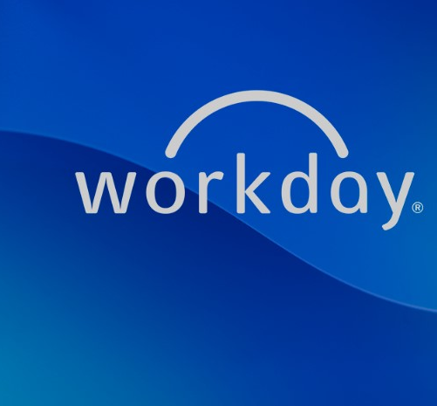
Payroll as a Service
June 2026

Slide 2


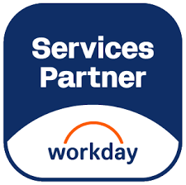


















Mivada
Australian Owned Business
Proudly Owned and Operated in Australia, understanding the local market and business culture
We Are Not a Big 4
Agile, Flexible, and Customer-Focused — without the bureaucracy or inflated overheads
Local Engagement Manager
Supported by a Dedicated Engagement Manager and Australian based Solution Consultants to ensure responsive and tailored service delivery.
Direct Access to Our CEO
Escalation directly to the CEO for faster decision-making and resolution of critical issues impacting your business.
We work with notable brands such as…

Slide 3
Why Payroll as a Service?
Mivada is built on a team of payroll professionals with over 25+ years of experience running payroll individually
We have spent the last 10 years at Mivada watching clients struggle with the ever-changing world of payroll and subsequent legislative compliance requirements
Offering Payroll as a Service to clients is the future of payroll, it extends beyond simply being the Application Managed Services partner or providing resources to fill gaps, this is about taking the hassle out of payroll for clients with fully dedicated experienced professionals to deliver the best for their employees
With hybrid approaches to capability onshore and offshore, onsite or remote, Mivada will manage all payroll needs for the client through their Workday Payroll instance

Slide 4

Mivada - Payroll as a Service
Mivada Payroll as a Service provides clients with an end-to-end payroll delivery service including the following:
Payroll generation and employee payment
Third Party reconciliations (Super, ATO and any additional deduction processing on behalf of the employee)
Finance GL reporting back to the client post pay period close
Reporting for People / Operations teams
Payroll as a Service results in a reduction of internal support required to process payroll:
Internal IT Support & Governance (no longer required)
AMS support (no longer required)
Payroll Resources (reduction)
People Team
HR Business Partner(s)
IR/ER
Remuneration & Benefits
Payroll Representative
Mivada
Payroll as a Service
Operations Team
Payroll System
Workday
(Client Tenant)
HR System
Workforce Rostering / T&A System(s)
People Data Reporting
Finance / Banking /
3rd Party payments

Slide 5
Payroll as a Service – Operating Model
Service Scope
Payroll Processing (monthly, fortnightly, weekly): Earnings, deductions, tax, superannuation
Delivery Model
Onshore Payroll SMEs: Based in Australia for compliance and governance
Governance Structure
Client Governance Lead: Escalation point and strategic oversight
Compliance: Fair Work, ATO STP, Superannuation Guarantee, NES adherence
Employee Lifecycle Updates: Hires, terminations, employee lifecycle changes
Leave & Absence Management: Entitlements, accruals, payouts
Year-End Processing: income statements, reconciliations
Reporting & Analytics: Payroll reports, GL extracts, compliance metrics
Offshore/Hybrid Ops Team (optional): Transactional processing for scale and cost-efficiency
Payroll Delivery Manager (Mivada): Accountable for end-to-end service
Service Delivery Team: Processing, validations, exception handling
Weekly Ops Review: SLA performance, issue resolution, payroll calendar review
Monthly Governance Review: Compliance, changes, risks, improvements
Service Levels (SLAs & KPIs)
Technology & Tools
Compliance & Risk Management
Payroll Accuracy: >99.5%
On-Time Payroll Processing: 100%
STP Filing Timeliness: 100%
Query Resolution Time: <2 business days
Compliance Updates Applied: Within 5 working days of regulatory change
STP Reporting to ATO: Managed and reconciled each pay run
Superannuation Processing: Per statutory schedule (SG and voluntary) PayDay Super
Fair Work Compliance Checks: Pay rates, entitlements, NES compliance
Audit Trails: For all payroll actions and corrections
Data Security & Privacy: Aligned with Australian Privacy Principles (APPs)
Payroll System: Workday
Knowledge Base & SOPs: For standardised and auditable processes
Ticketing System: For support and tracking (e.g., Jira, ServiceNow)
Integration Support: Middleware monitoring & data flow validation
Helpdesk Support: Tier 1 (queries), Tier 2 (exception handling)
Integration Managed Services: Support for interfaces with HR, finance, banking, ATO, super funds
Continuous Improvement: Automation, process enhancements, legislative updates
Value Realisation
Continuous Improvement: Monthly retrospectives and automation initiatives
Change Management: Communication plans for legislative and system changes
Innovation Projects: Employee self-service, AI-assisted query resolution
Cost Transparency: Clear metrics on per payslip cost and efficiency gains

Slide 6
Payroll as a Service - Operating Model
Payroll as a Service
Payroll Administrators
Tax & Superannuation Specialist
Reporting & Insights Specialist
Payroll Officers
Client Services Manager
Implementation Consultants
Payroll Support Officers
Payroll Delivery Manager
Oversees payroll operations, client relationships, escalations, and compliance
Manages onboarding, client queries, SLA tracking, and reporting
Supports Tier 1 client or employee queries
Leads new client setups, transitions, and system configurations
Process pay runs, leave, superannuation, PAYG, STP reporting
Maintains payroll software, integrations, and data accuracy
Ensures PAYG, super, and tax obligations are met correctly
Delivers payroll metrics, dashboards, and workforce analytics

Slide 7
Indicative Costing
Per Payslip charging model - $19.99 - $29.99 depending on complexity of the payroll calculations
Additional Services can include:
Workday Payroll Configuration Health Check
Payroll System Migration to Workday
Remediation
Integration & Technology Support

Slide 8
Common Client Payroll Landscape
A common internal payroll landscape includes all payroll resources being inhouse and managed by the customer.
The Payroll team can include:
Payroll Manager
Team Leaders
Payroll Officers
Payroll System Administrators
Payroll Accountant
Additionally supporting the payroll services are the following teams:
Internal IT Support & Governance
Vendor AMS
People Functions
HR Business Partner(s)
IR/ER
Remuneration & Benefits
Payroll Team
Operations
Payroll Vendor AMS
Payroll System
HR System
WP / T&A System
IT Support
IT
(Support & Governance)
Finance / Banking /
3rd Party payments

